Slide 1

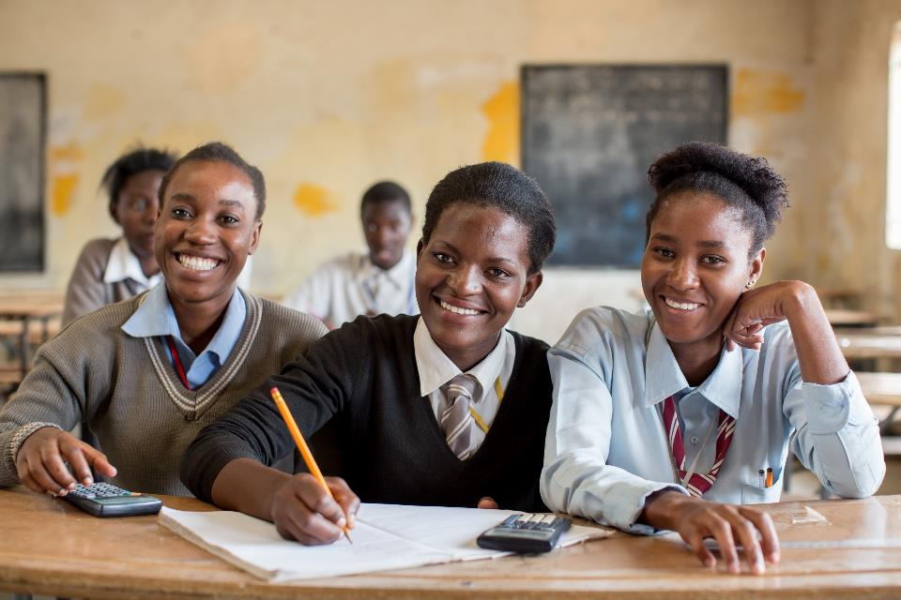
HIV and prevention challenges among adolescent girls and young women
Presented at the PACT Preconference meeting,
21/07/18, IAS 2018, Amsterdam
Dr. Chewe Luo MD, PhD, FRCP
Associate Director, Programmes, Chief HIV Section,
UNICEF Headquarters, New York
© UNICEF/UN070230/Chisiza

Slide 2
Presentation outline
Results to date and state of the epidemic
Where are we headed? – Global commitments
Understanding determinants of infection
What do we need to do?
Conclusion

Slide 3

HIV investments have resulted in fewer deaths and new child infections among children
Data source: Global AIDS Monitoring 2018 and UNAIDS 2018 estimates

Slide 4
We have more to do to achieve epidemic control
Although there are less new infections in younger children, for adolescents the decline has flatlined
Data source: UNAIDS 2018 estimates

Slide 5
We have to address multiple vulnerabilities in adolescent girls and young women to radically change the trajectory towards the 75% reduction, down to <100,000 new infections
Data source: UNICEF analysis of UNAIDS 2018 estimates

Slide 6
There were 340,000 new infections among adolescent girls and young women, in 2017
Infections among AGYW is almost a quarter (21%) of all adult new infections
  82% of these infections occurred in sub-Saharan Africa
  Proportion > a quarter in sub-Saharan Africa (28%)
  Outside sub-Saharan Africa, AGYW represent 10% of new infections
  Key populations and their partners represent about 40%of new infections outside sub-Saharan Africa

Slide 7
In three regions, adolescent girls experience more new infections than adolescent boys
Data source: UNAIDS 2018 estimates

Slide 8
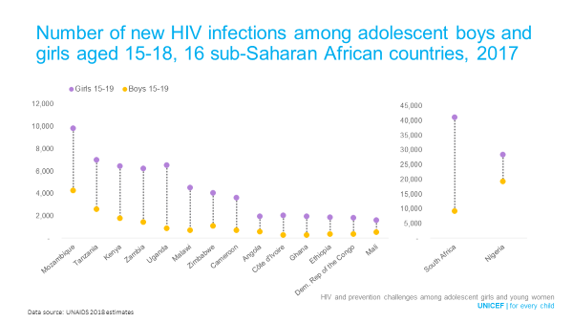
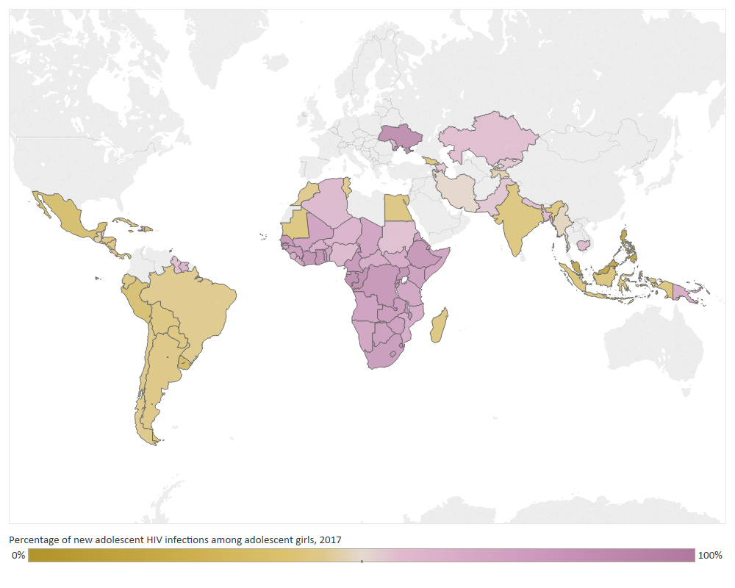
In many countries adolescent girls are at higher risk than boys for HIV infection
Proportion of new adolescent HIV infections occurring
among adolescent girls, 2017
Data source: UNAIDS 2018 estimates

Slide 9
About 2.4 million adolescent girls and young women are living with HIV in 2017; 2.0 million live in sub-Saharan Africa
Data source: UNAIDS 2018 estimates

Slide 10
Getting ahead of HIV with adolescent girls
Data source: Demographic & Health Surveys (DHS) 2013-2017

Slide 11
Adolescents living with HIV receive inadequate access to antiretroviral therapy

Slide 12
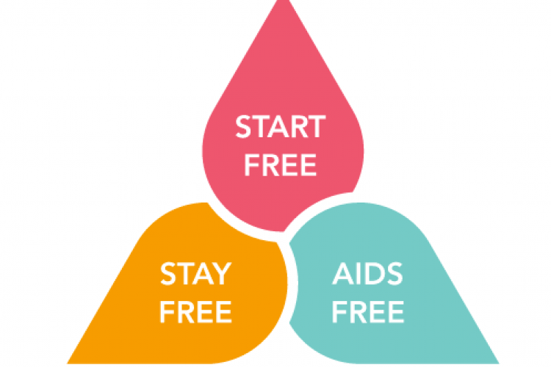
Where are we headed ? 2016 HIV High Level Forum Commitments
In 2016, the world committed to
ambitious HIV:
Prevention targets
a) Children (start free) - <20,000 new infections in 2020
b) Adolescents &young women (stay free) - <100,000 in 2020
Treatment Targets
Children and adolescents (AIDS Free)
Provide life long HIV treatment to 95% of children and adolescents living with HIV
How we perform in the remaining 29 months around adolescents and young women will drive our ability to achieve epidemic control by 2030.

Slide 13
HIV Prevention Coalition and 2020 Roadmap commitment
75% reduction in HIV infections to < 500 000 infections by 2020 at population level
  < 100, 000 in adolescent girls and young women

Slide 14

Understanding determinants of infections
Gender norms that promote sexual ignorance among girls
  Girls have lower correct knowledge about HIV risk
  60% are sexually active by age 18
Older sexual partner and lower condom use
Intimate partner violence (as high as 30%)
Injection drug use (about 50% under 18)
Multiple vulnerabilities of AGYW - early sexual debut, teenage pregnancy, school drop out
  Magnified in OVCs
  Associated later sexual risk taking
Biological risk factors
Hardee et at 2014; Karim et al 2018

Slide 15
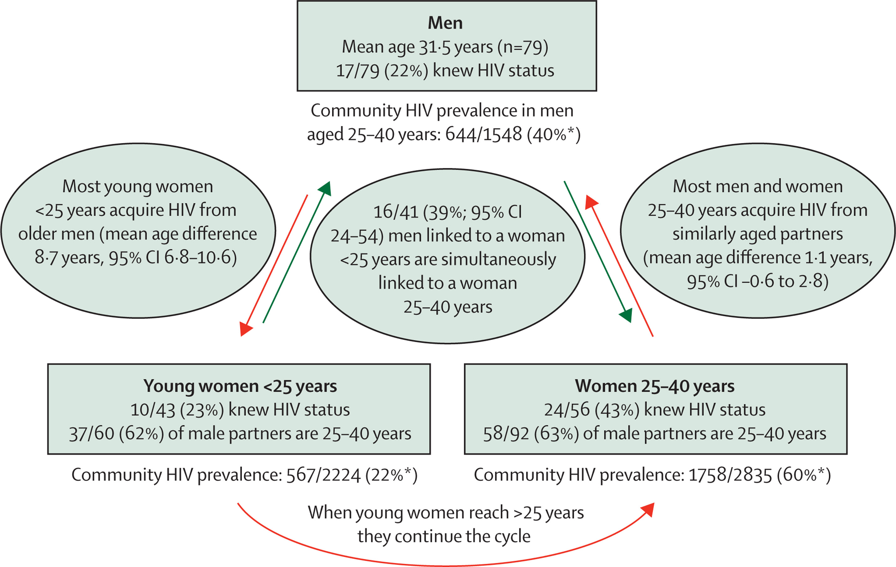
Cycle of HIV transmission, results from a phylogenetic study, KwaZulu-Natal, South Africa, 2016
Source: Centre for the AIDS Programme of Research in South Africa, 2016.

Slide 16
In sub-Saharan Africa, fewer girls and young women report condom use than boys and young men
Data source: DHS and MICS 2010-2017

Slide 17
Women and girls are having sex before age 20
Data source: Demographic & Health Surveys (DHS) 2010-2017

Slide 18
Up to 23% of girls experience forced sex during adolescence
Data source: DHS and Multiple Indicator Cluster Surveys (MICS) 2005-2016

Slide 19
What do we need to do?

Slide 20
We have programming guidance to inform action
Situation analysis
  Adolescent girls and young women in the context of the network of transmission
Options menu
  Context-specific programming
  considering local epidemic
  patterns & resource availability

Slide 21
Options MENU
Dimension of
change
HIV prevention
outcomes
Menu options
Impact
Condoms
Fewer partners/ more partnerbb choice
(less risky partners)
School-based prevention
(in context of comprehensive sexuality education)
Norms, know how, skills
Core prevention programs
Interpersonal communication
Reduced
HIV incidence
Support choices
of young
women who have
agency
Pre-exposure prophylaxis
Safer sex negotiation (condom use)
HTS, ART, VMMC for men
Biological factors
Policy, legal change
Community mobilization
Consistent use of ARVs for prevention (ART, PrEP, PEP)
Reduce
susceptibility
and transmissibility
Synergistic
effects on education, GBV, gender norms, SRHR
Multi- and new media
Policy & structural action
Cash transfers / incentives
Structural factors
More men go for HIV/health services (HTS/ART & VMMC)
Gender norms & GBV prevention
Sexual and reproductive health and rights
Enhance agency
among
young women
Enhanced leadership

Slide 22


The Core Package
Empower Girls & Young Women and reduce risk
Mobilize Communities for change
Reduce Risk of Sex Partners
Strengthen Families
Community Mobilization & Norms Change
School-Based
Interventions
Additive Funding VMMC
Parenting/ caregiver Programs
Additive Funding
TX for Men
Characterization of male partners to target highly effective interventions (HTS→ART, VMMC)
Social Protection
(Cash Transfers, Education Subsidies, Combination
Socio-Economic Approaches)
Youth-friendly sexual and reproductive health care (Condoms, HTC, PrEP, Contraceptive Mix, Post-violence care)
Social Asset Building

Slide 23
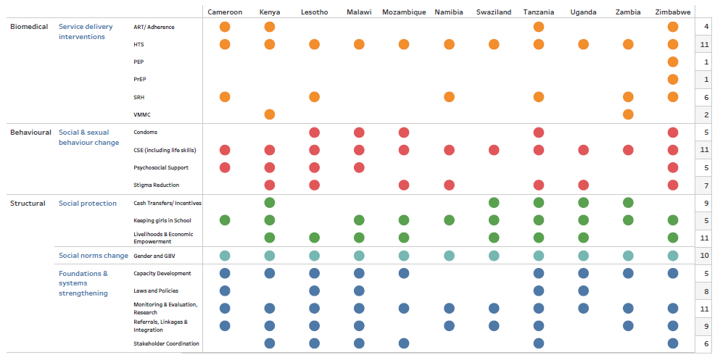
GF AGYW INTERVENTIONS- Summary of Investments (2018-2020)

Slide 24
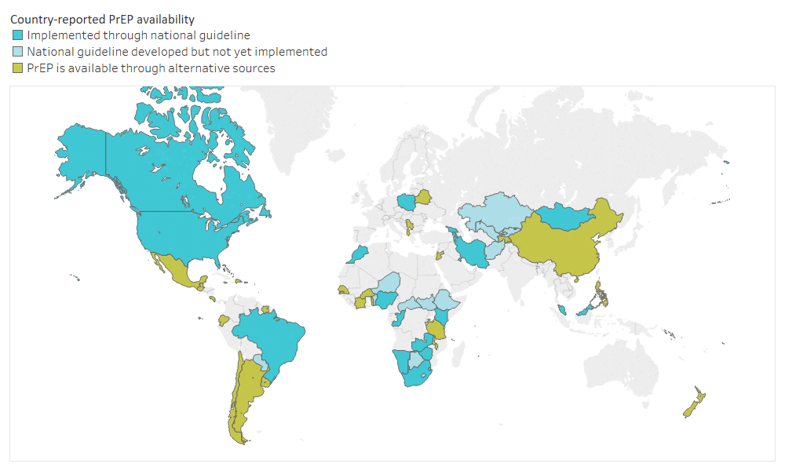
Introduction of new innovations: Status of PREP policies and implementation, in 2018
Countries reporting PrEP availability by type of availability
Data source: Global AIDS Monitoring 2018
Note: Alternative sources include pilot studies, research, private providers, internet, etc.

Slide 25
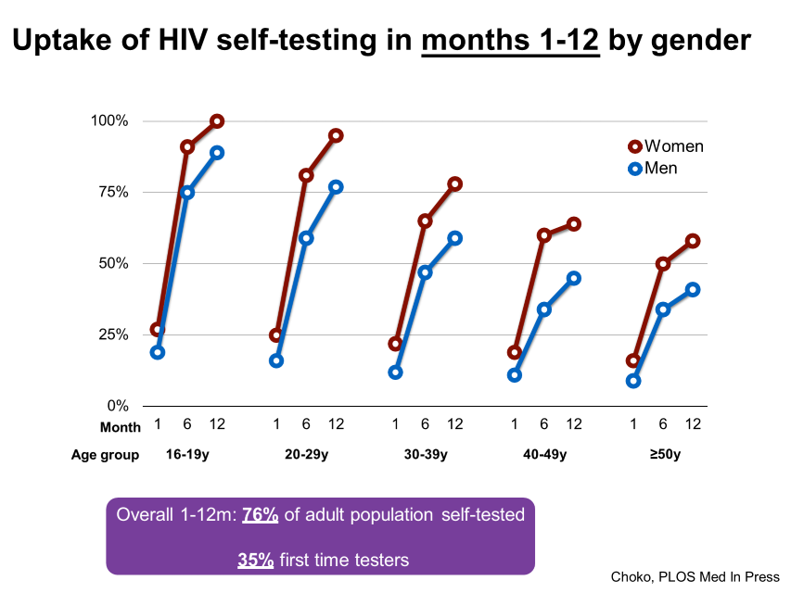
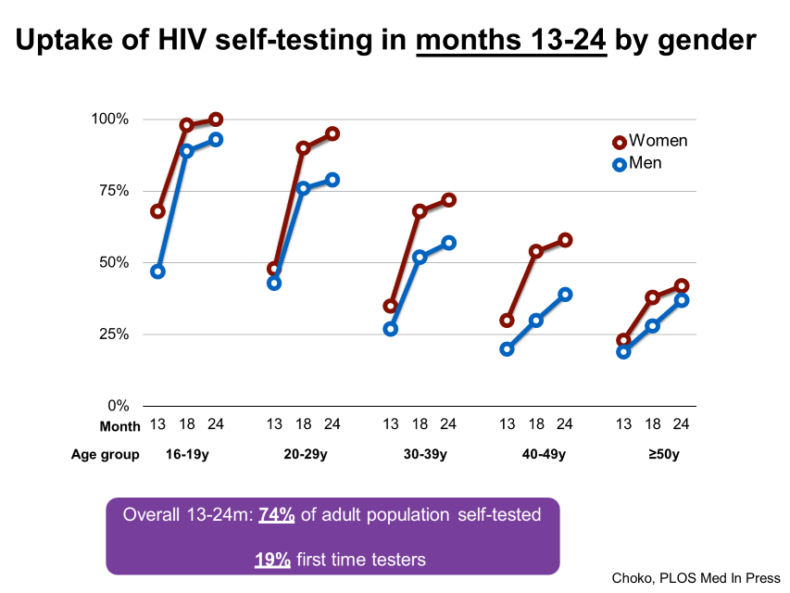
Introduction of new innovations: Uptake of self testing among adolescents and young people
Data source:
Dr Peter MacPherson, IAS Vancouver, 2015

Slide 26
Conclusions
Our understanding has improved
Scale up responses must:
  Be based on the key drivers of the epidemic and what works
  Also leverage existing investments in other sectors
  Define coordination and management structures for accountability
More data work needed for size estimation especially for adolescent and young key populations
We need better assessments of who is being left behind for better impact and saturation of the various interventions
Participation of adolescents in the design of our programmes is key

Slide 27
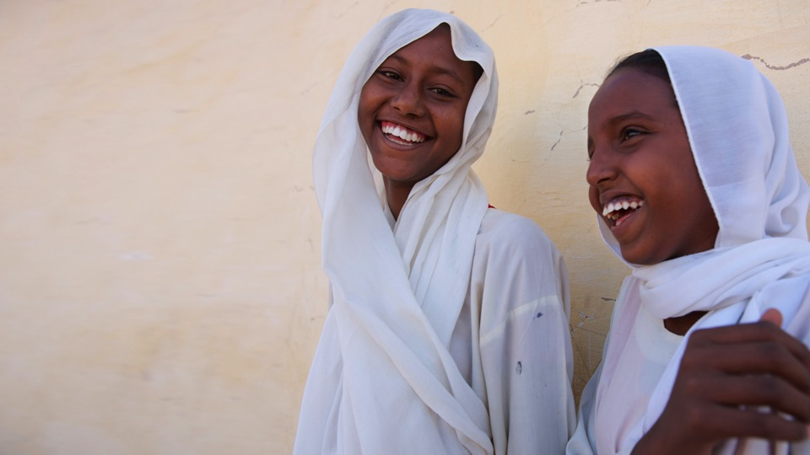
Thank You
Acknowledgements:
Damilola Walker
Chibwe Lwamba
Aleya Khalifa
© UNICEF/SUDA2014-XX228/Noorani

